Slide 1

Topic: My Professional Presence: CV, Resume & LinkedIn
Presented By
Name: Priyanka Paul
ID:0322310205101062
Batch:22th
Semester:5th

Slide 2
Introduce Myself
Hello! I’m Priyanka Paul.
I’m currently a student of Computer Science and Engineering (CSE) at Pundra University of Science and Technology , where I’m exploring the exciting world of technology. My true passion lies in Artificial Intelligence (AI) —I’m fascinated by how it’s transforming the way we live and work.
As an AI enthusiast, I love diving into topics like machine learning, data science, and automation. I enjoy working on projects, experimenting with new ideas, and staying updated on the latest advancements in tech. I believe that AI has immense potential to solve real-world challenges, and I’m excited to be part of this innovative field.
When I’m not studying or coding, you’ll probably find me brainstorming creative solutions, participating in hackathons, or connecting with others who share my enthusiasm for technology.
Looking ahead, I aspire to grow as a professional in AI and contribute to building impactful solutions that can make a difference. If you’re passionate about tech or AI, let’s connect—I’d love to exchange ideas and learn from each other!

Slide 3
What is a CV?
📜 Curriculum Vitae (CV): A detailed document showcasing your education, work experience, achievements, and skills.
Key Features:
Length:
2–3 pages or more (no strict limit).
Content:
Full academic history (degrees, research, publications).
Detailed work experience (including internships, projects).
Certifications, awards, and professional affiliations.
Purpose:
Showcases your entire career journey and expertise.

Slide 4
What is a Resume?
📄 Resume: A concise document summarizing your skills, experience, and qualifications.
Key Features:
Length:
1–2 pages (short and to the point).
Content:
Key skills and achievements.
Work experience (focused on relevance to the job).
Education and certifications (briefly mentioned).
Purpose:
Quickly demonstrates your fit for a specific role.
Page 3

Slide 5
Importance of LinkedIn
🌐 LinkedIn:
A professional networking platform to showcase your skills and career journey.
Helps in job searching, networking, and connecting with industry experts.
Employers and recruiters use it to find potential candidates.
Allows you to share projects, articles, and achievements to build your brand.
Why LinkedIn Matters:
Professional Branding: Showcases your skills, experience, and achievements.
Networking: Connects you with industry professionals, recruiters, and mentors.
Job Search: Features job postings tailored to your profile. Allows recruiters to find and contact you directly.
Learning & Growth: Access to LinkedIn Learning for skill development. Stay updated on industry trends and news.
Page 4

Slide 6
Tools Used to Create CV & Resume
Tools Used to Create CV:
Microsoft Word:
Ideal for customizing and formatting a CV professionally.
Features: Templates, formatting tools, spell check.
Tools Used to Create Resume:
Canva
User-friendly platform with customizable templates.
Features: Drag-and-drop editor, design elements, and export options.
Microsoft PowerPoint
Used for creative and visually appealing resumes.
Features: Shapes, icons, and design flexibility.

Slide 7
LinkedIn Profile Overview
Key Sections of a Strong LinkedIn Profile:
Professional Profile Picture: A clear and high-quality image that represents my professionally.
Headline: Artificial Intelligence Enthusiast || Machine Learning Enthusiast
About Section: Hello! I’m Priyanka Paul,I’m currently a student of Computer Science and Engineering (CSE) at Pundra University of Science and Technology , where I’m exploring the exciting world of technology. My true passion lies in Artificial Intelligence (AI) —I’m fascinated by how it’s transforming the way we live and work.
Experience Section: Artificial Intelligence Intern| CodSoft | Feb 2025 - Present
Skills: NumPy, Pandas, Matplotlib, Seaborn, Scikit-learnTensorFlow, PyTorch.
Certifications: IBM Machine Learning Certificate by IBM,Programming Foundations with JavaScript, HTML and CSS Certification Course by Duke University.
Projects: Building Smarter Conversations with AI Chatbots| Jan 2025 - Feb 2025

Slide 8
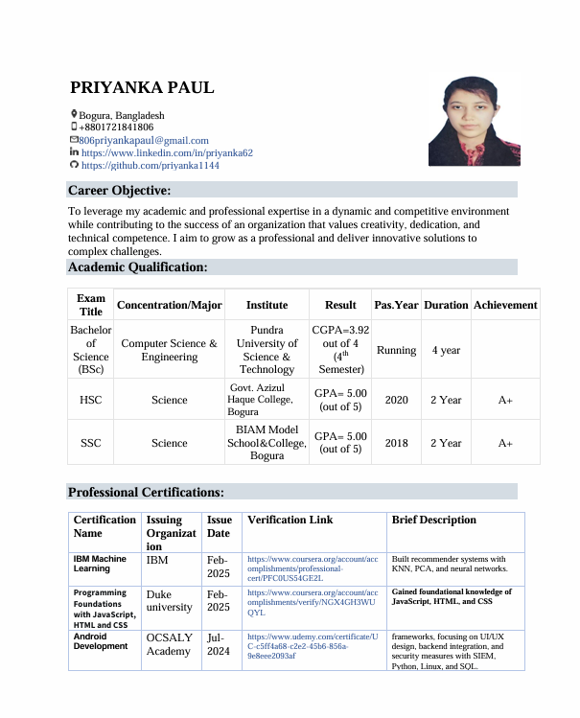
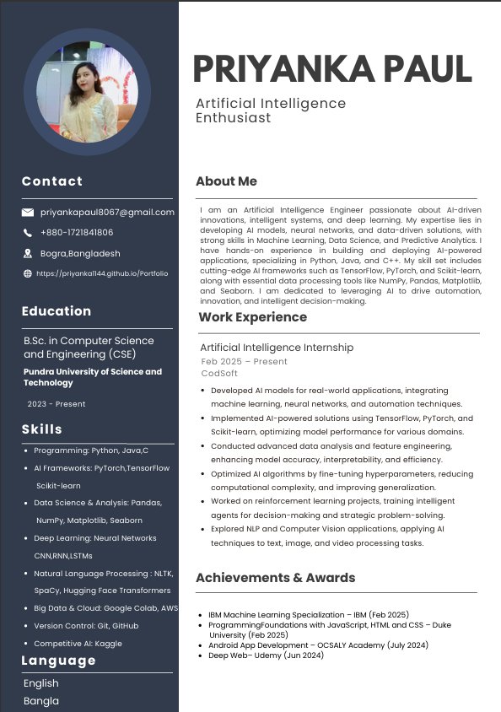
CV & Resume (With Screenshots & Links)
CV Screenshot:
Resume Screenshot:
See My CV
See My Resume

Slide 9
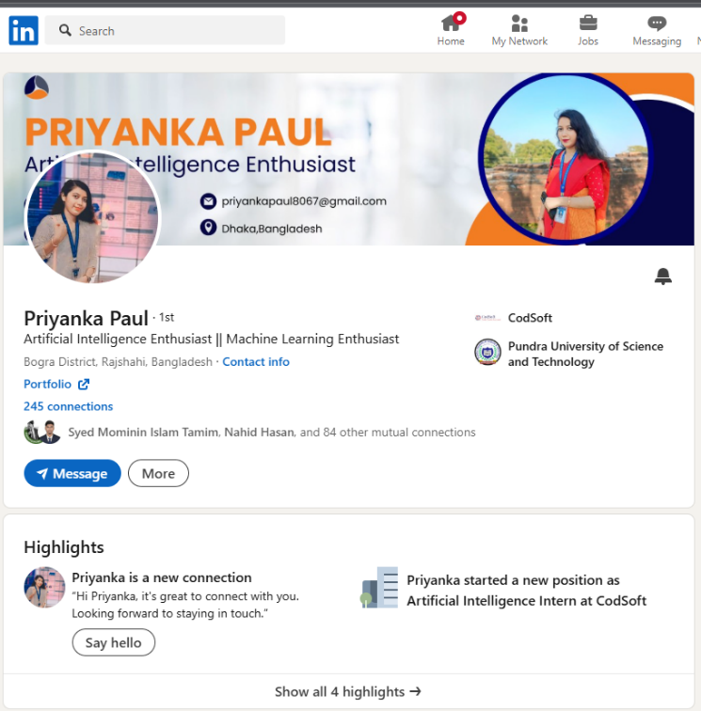
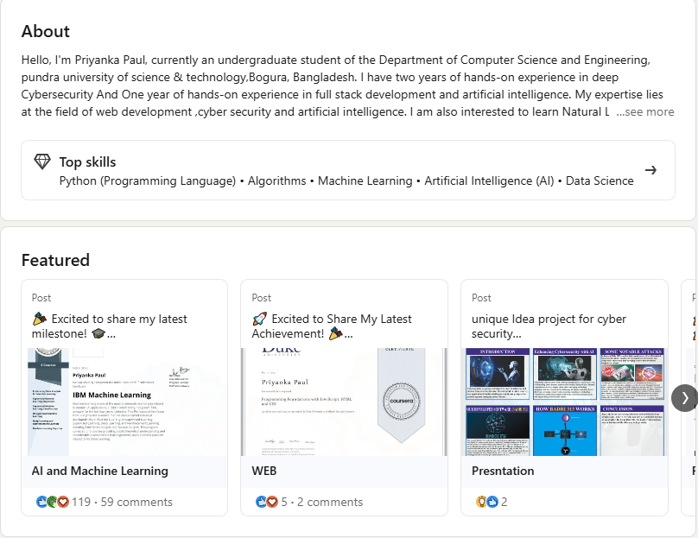
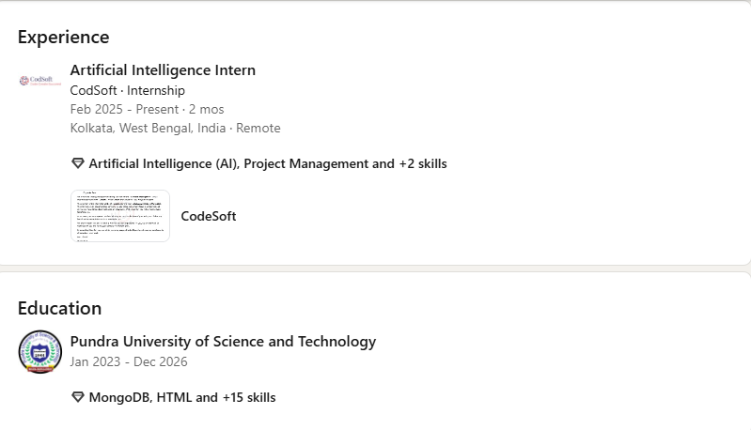
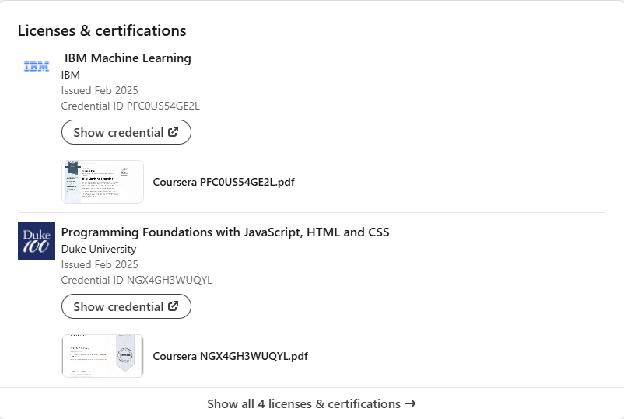
LinkedIn (With Screenshots & Links)

Slide 10
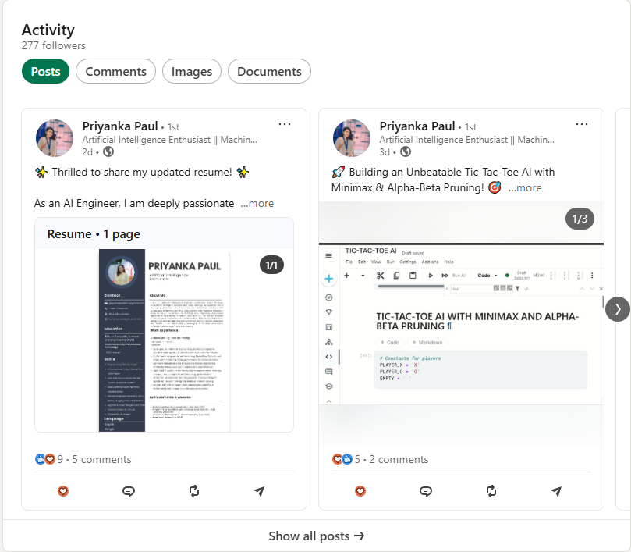
LinkedIn (With Screenshots & Links)
Visit My LinkedIn Profile

